Slide 1
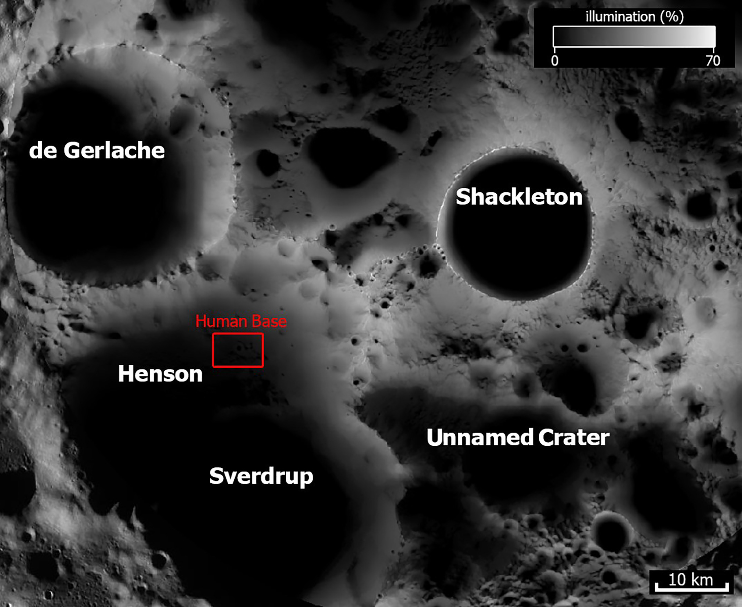
Sverdrup - Henson
LSIC Joint Surface Power and ISRU Telecon, Jan 17, 2024
A suitable place for the first lunar settlement

Slide 2
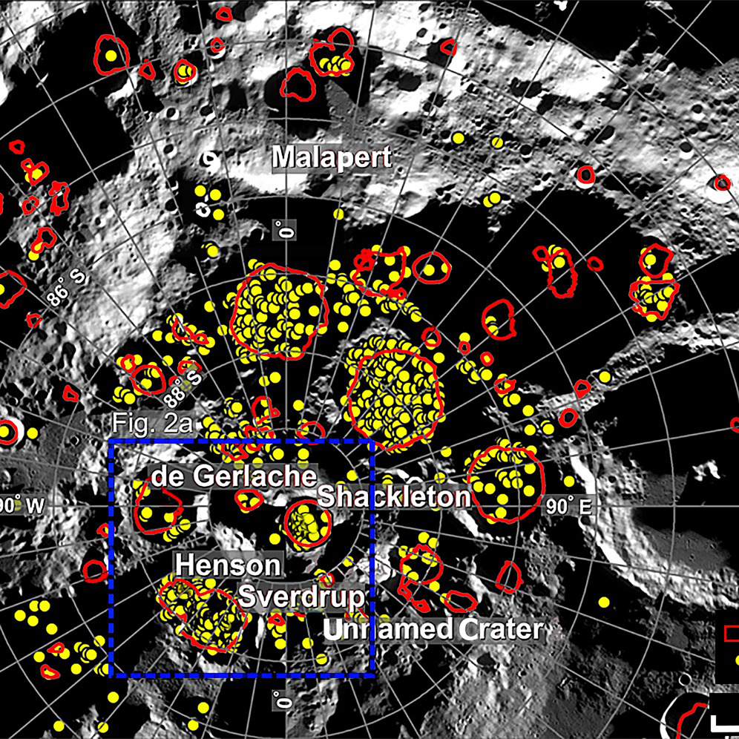
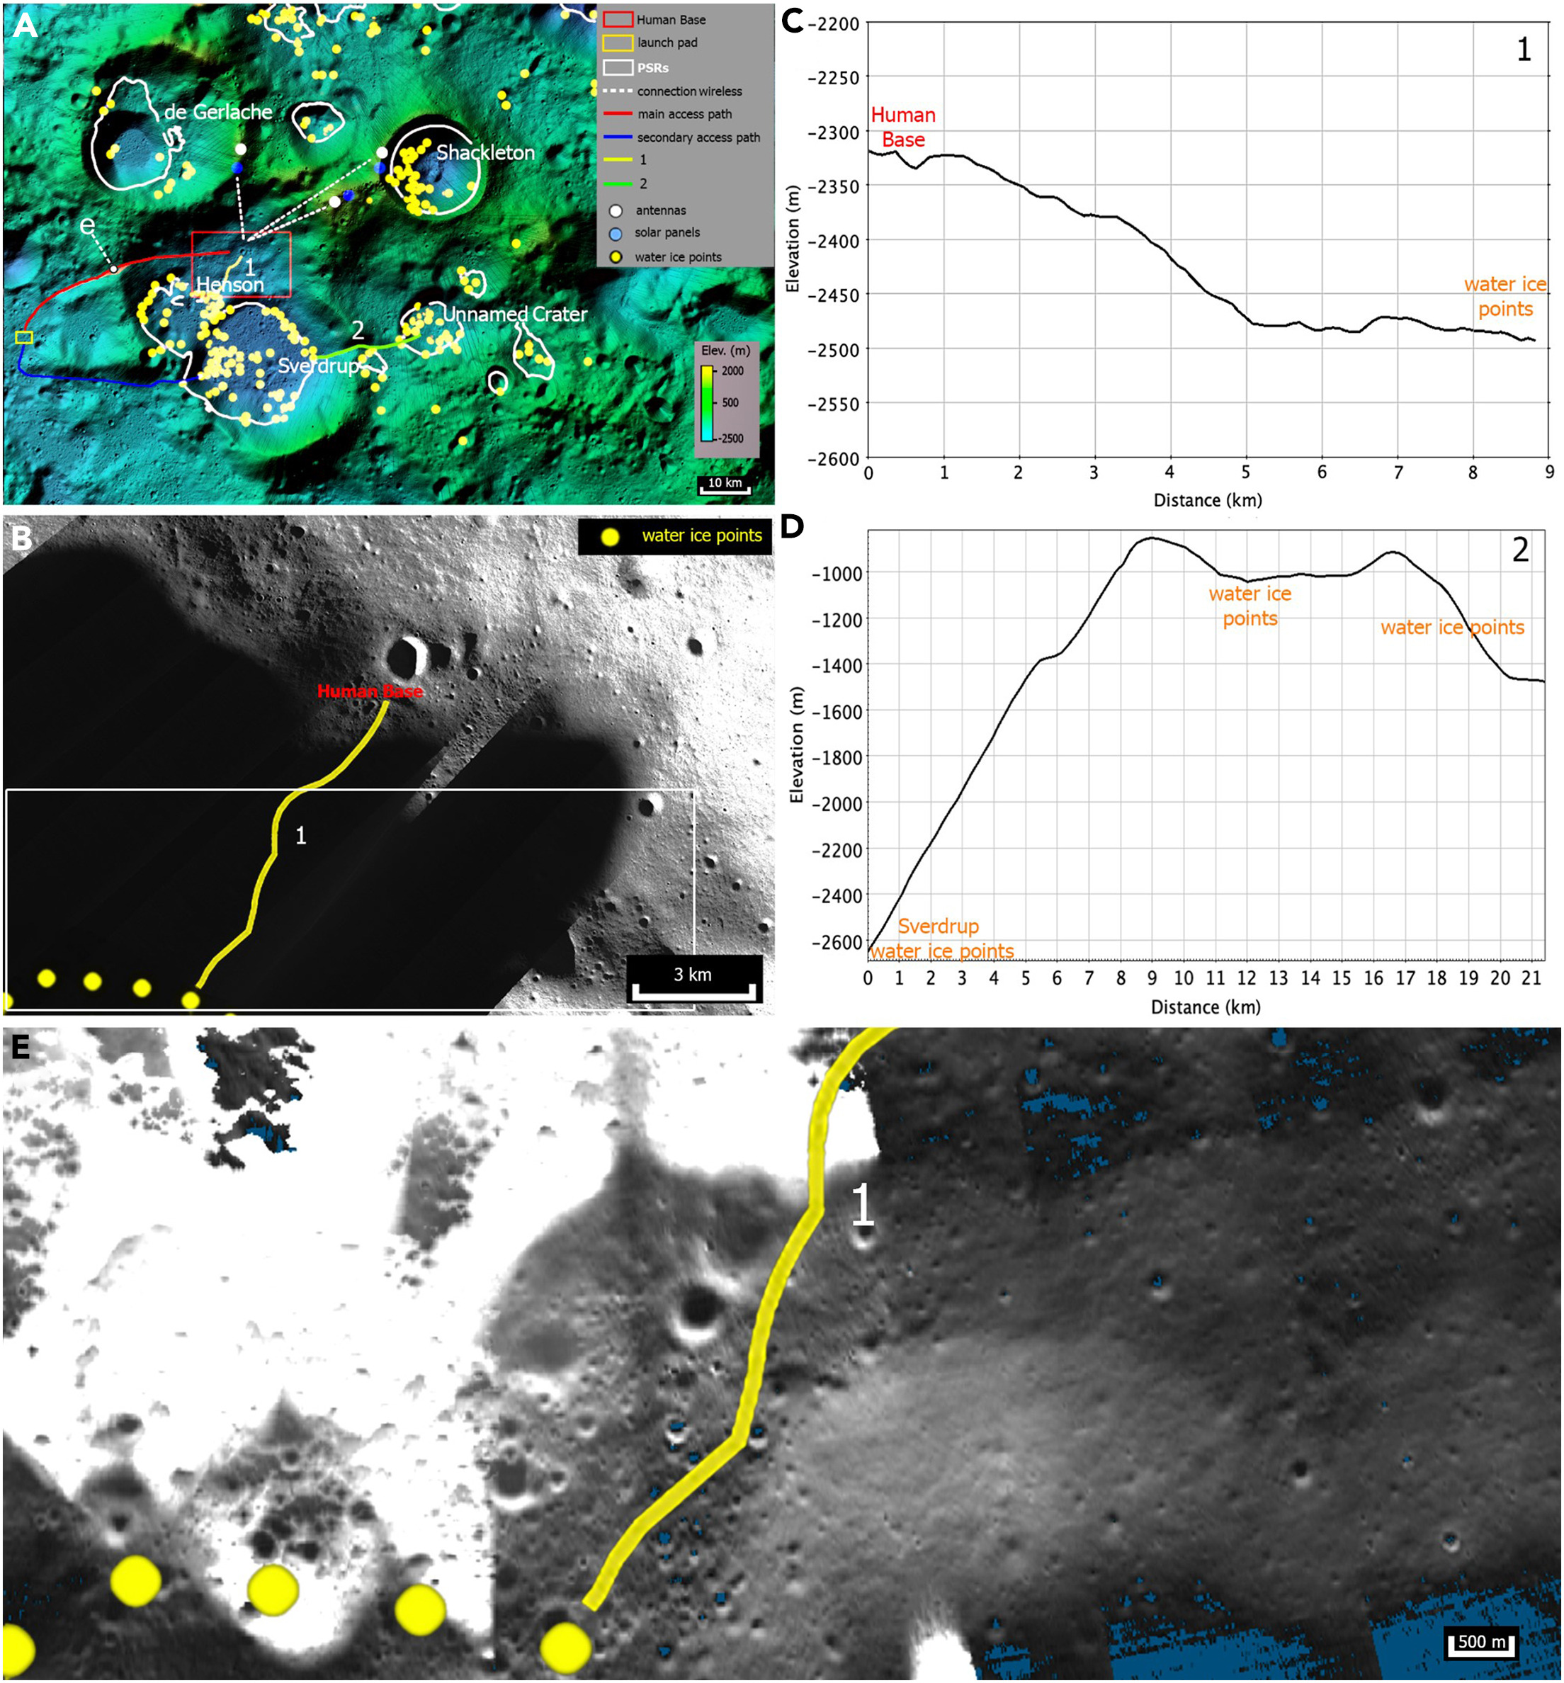
The Southern Polar region of the Moon
Regional view
Local view

Slide 3
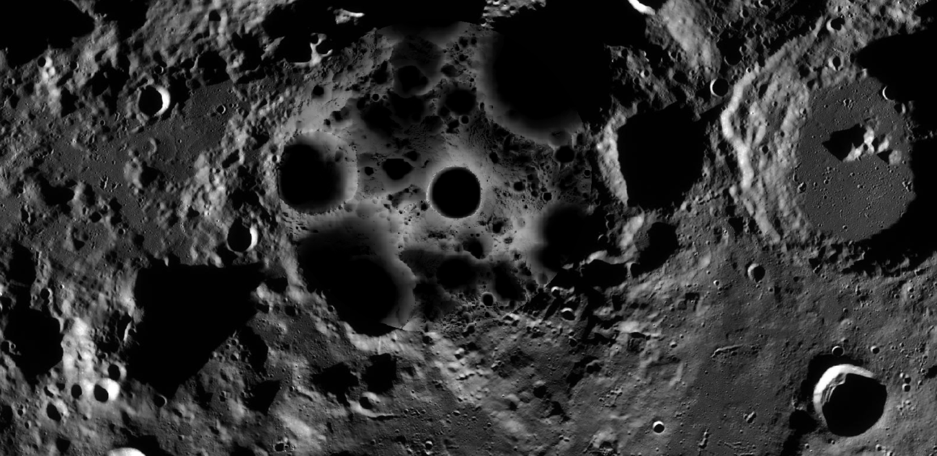

Slide 4
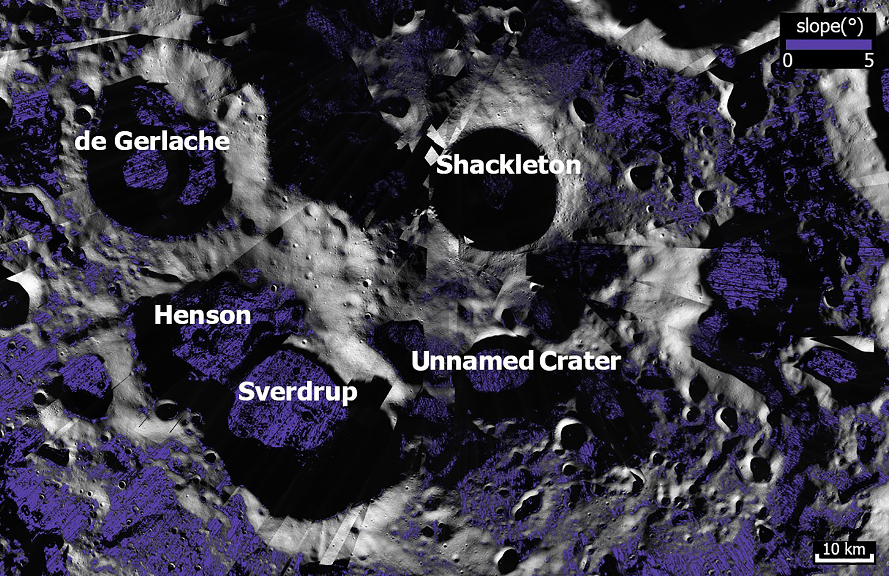
Slope map

Slide 5
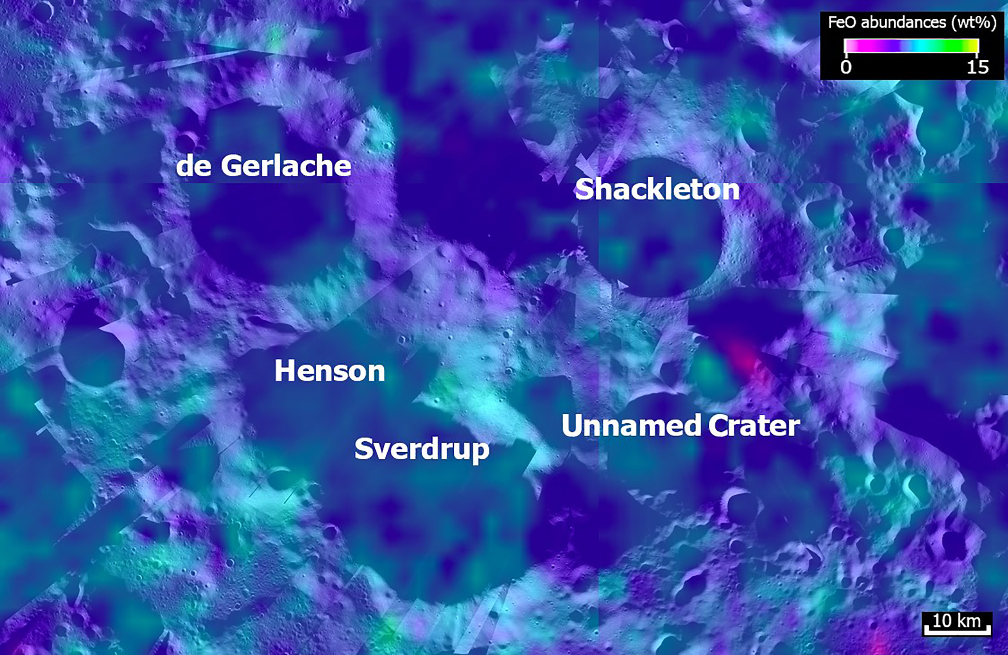
Iron oxide

Slide 6
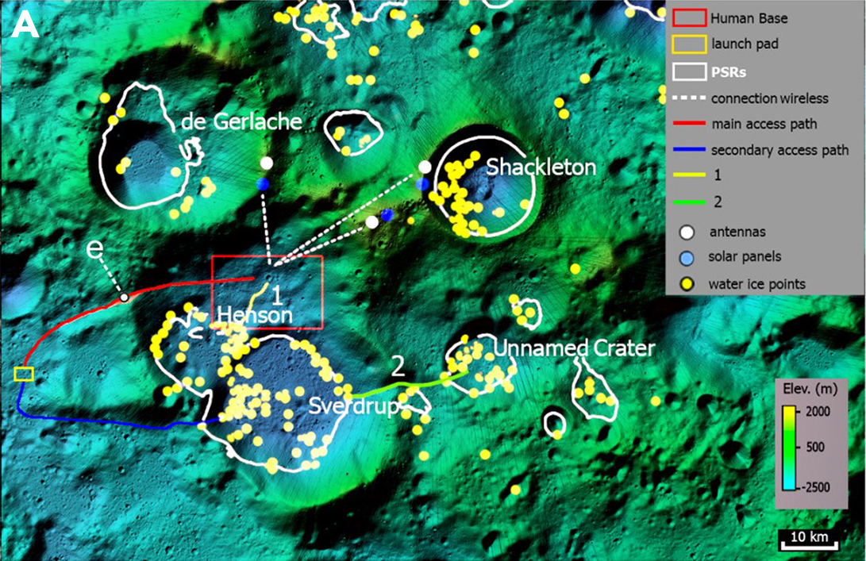
Launch-pad
(option)
Open space
(another option
for launch-pad
or other facilities)

Slide 7
Comparison between sites of interest
Sverdrup - Henson
De Gerlache
Excellent spatial density of water ice: 131 points
Illumination: Good (<80%)
Presence of PSRs (area): 545 km²
Presence of FeO: Good (10-12 wt%)
Scarce spatial density of water ice: 14 points
Illumination: Very good (<90%)
Presence of PSRs (area): 235 km²
Presence of FeO: Average (6-7 wt%)

Slide 8
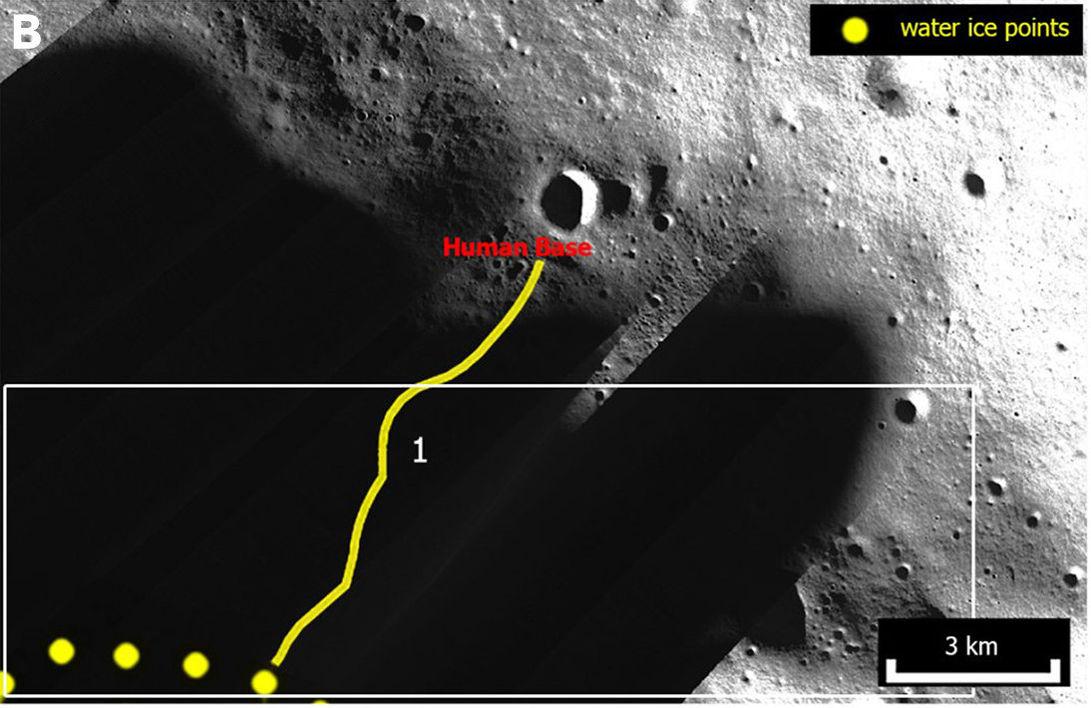
A journey into the darkness?

Slide 9
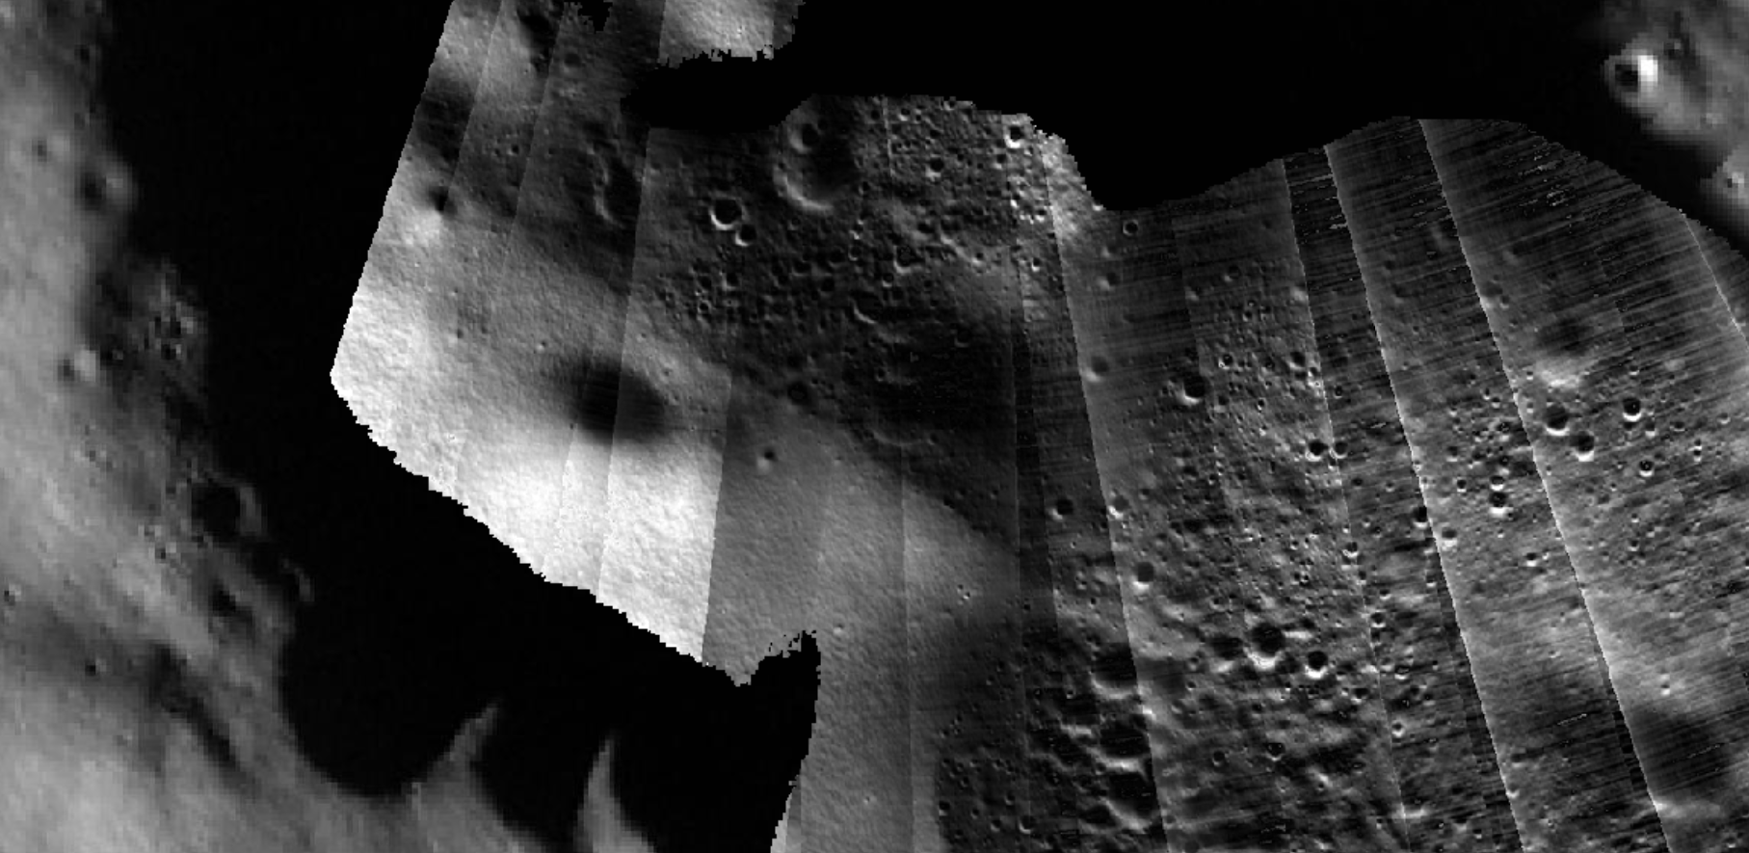
What’s inside the darkness?

Slide 10
Potentialities of Sverdrup - Henson
Higher presence of water detections with respect to nearby sites.
Best trade-off between illumination and accessibility to its floor and ISRU.
(Nearly) continuous communications with the Earth.
Enough PSR area for experiments or facilities requiring extreme cold temperatures.
Additional external flat areas for the expansion of the first settlement.
In short, a first solid foothold to explore (and possibly exploit) nearby sites.

Slide 11
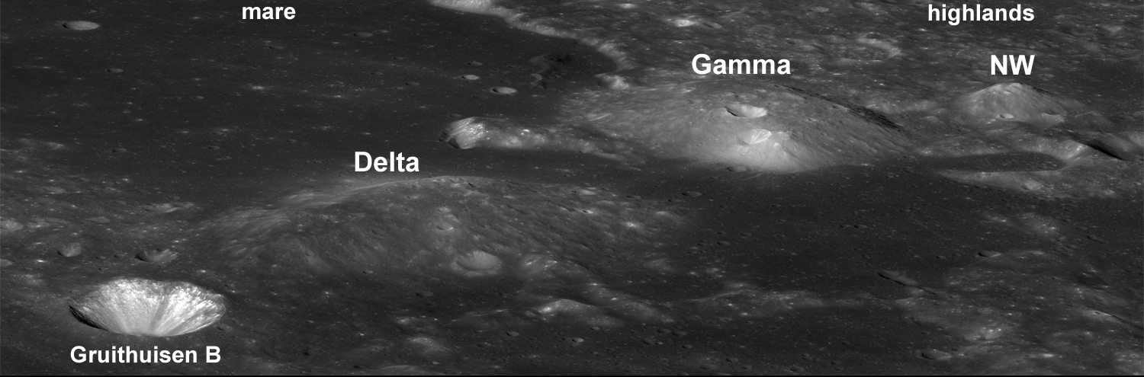
Thank you for your kind attention!

